Slide 1




Computer Fundamentals & Office Applications
Submitted by:
Md.Sahabur Rahman
University of Barishal

Slide 2
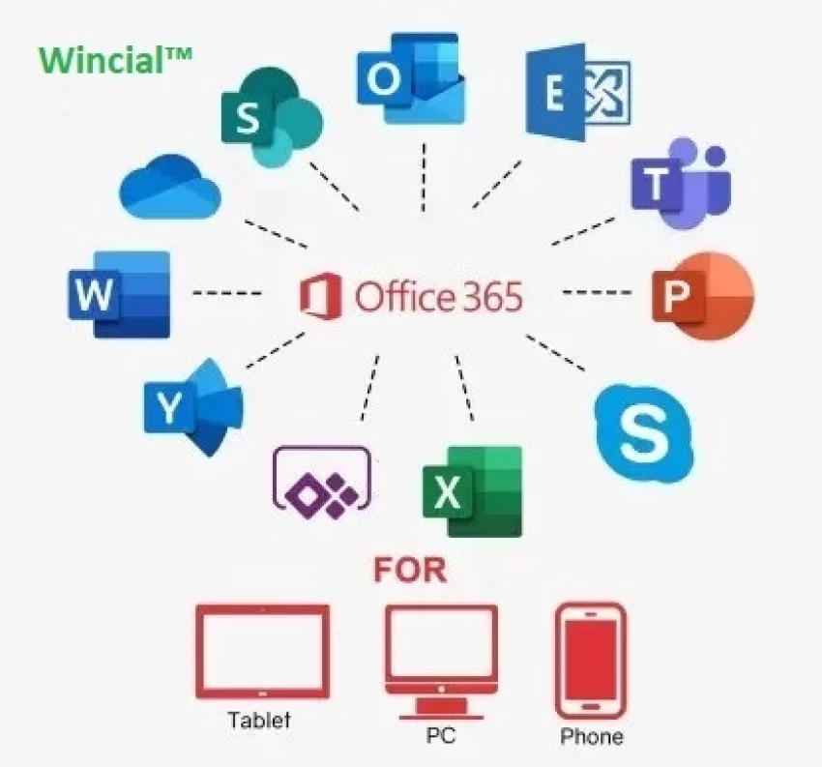
Course Contents:
Basic components of Computer
Microsoft Office Applications:
Microsoft Word
Microsoft Excel
Microsoft Powerpoint

Slide 3

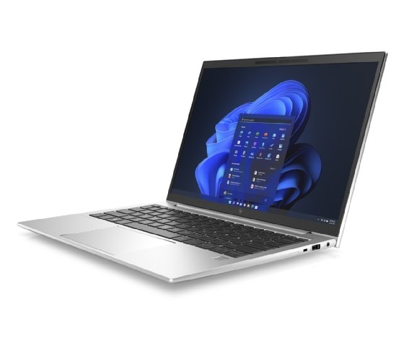
What is Computer?
A computer is a machine that can be programmed to automatically carry out sequences of arithmetic or logical operations (computation).

Slide 4
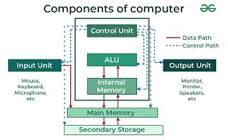
Basic components of Computer

Slide 5
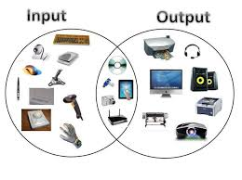
Input & Output Devices

Slide 6

What is ms word?
Used to make professional-quality documents, letters, reports, etc., MS Word is a word processor developed by Microsoft. It has advanced features which allow you to format and edit your files and documents in the best possible way.

Slide 7
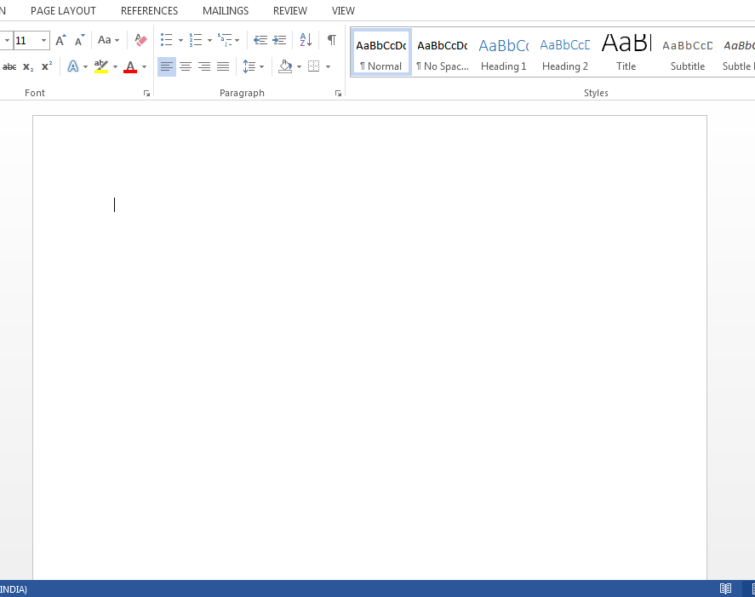
How to create an MS Word document?
To create an MS Word doc, follow the steps mentioned above to open Microsoft Word. Then once the program is open, click on “File” followed by “New”. This opens a new doc where something new can be created.
Since it is used by people of all age groups, in schools, in colleges and for official purposes, having proper knowledge of Microsoft Word is a must. The preview of the MS Doc file once it is opened is given below:

Slide 8
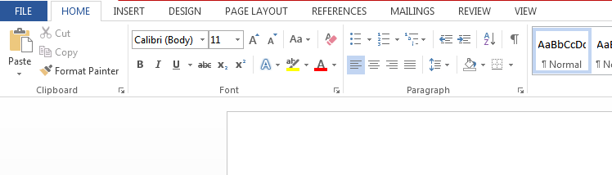
Features of MS Word:
Home
Insert
Design
Page Layout
References
Review
View
The image given below shows the different elements and categories which are
available in MS Word doc:
The basic functions of MS Word:
Creating text documents
Editing and Formatting the existing documents
Editing and Formatting the existing documents
Graphical documents, comprising images
Used by Authors and Researchers
Detect grammatical errors in a text document

Slide 9
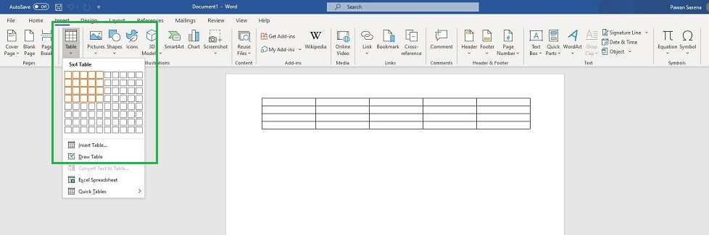
Some basic Functions
How to insert table:
For a basic table, click Insert > Table and move the cursor over the grid until you highlight the number of columns and rows you want. For a larger table, or to customize a table, select Insert > Table > Insert Table. Tips: If you already have text separated by tabs, you can quickly convert it to a table.

Slide 10
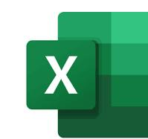
Ms Excel:
Uses of ms excel:
collection and verification of business data;
business analysis;
data entry and storage;
data analysis;
performance reporting;
strategic analysis;
accounting and budgeting;
administrative and managerial management;
account management
office administration.
MS Excel is a commonly used Microsoft Office application. It is a spreadsheet program which is used to save and analyse numerical data.

Slide 11
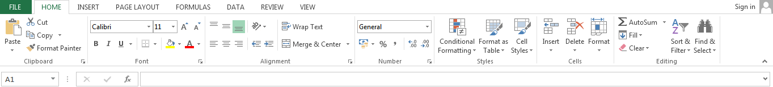
Features of MS Excel:
Various editing and formatting can be done on an Excel spreadsheet. Discussed below are the various features of MS Excel.
Home
Insert
Page Layout
Formulas
Data
Review
View
The image below shows the composition of features in MS Excel:
Basic Formulas:
Addition
Subtraction
Average
Maximum and Minimum
Concatenate
Count

Slide 12
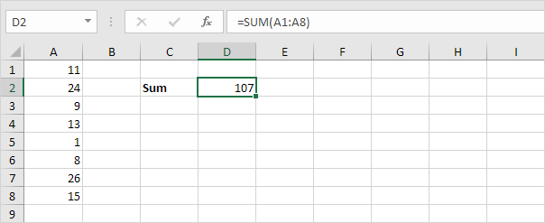
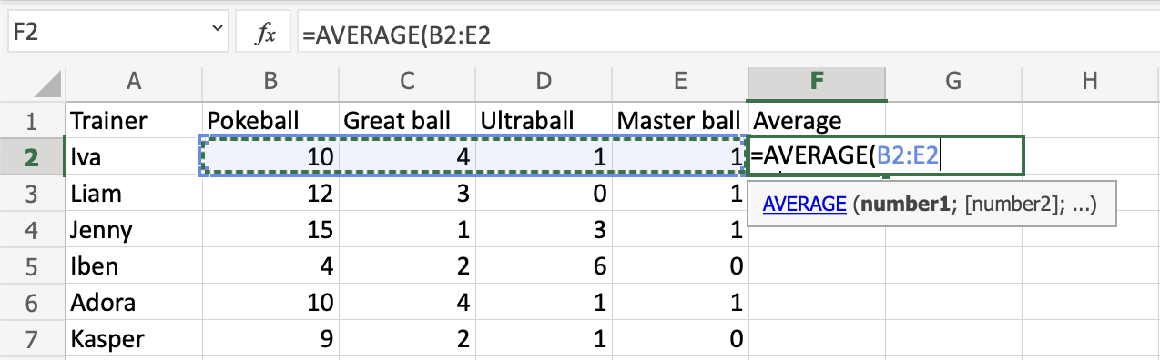
Some Functions:
Sum a Range:
simply type =SUM(A1:A8) to enter this formula. When you arrive at: =SUM( instead of typing A1:A8, simply select the range A1:A8.
Select a cell (F2)
Type =AVERAGE
Double click the AVERAGE command
Select a range (B2:E2)
Hit enter
Next, Fill F2:F7
How to use the =AVERAGE function, step by step:

Slide 13

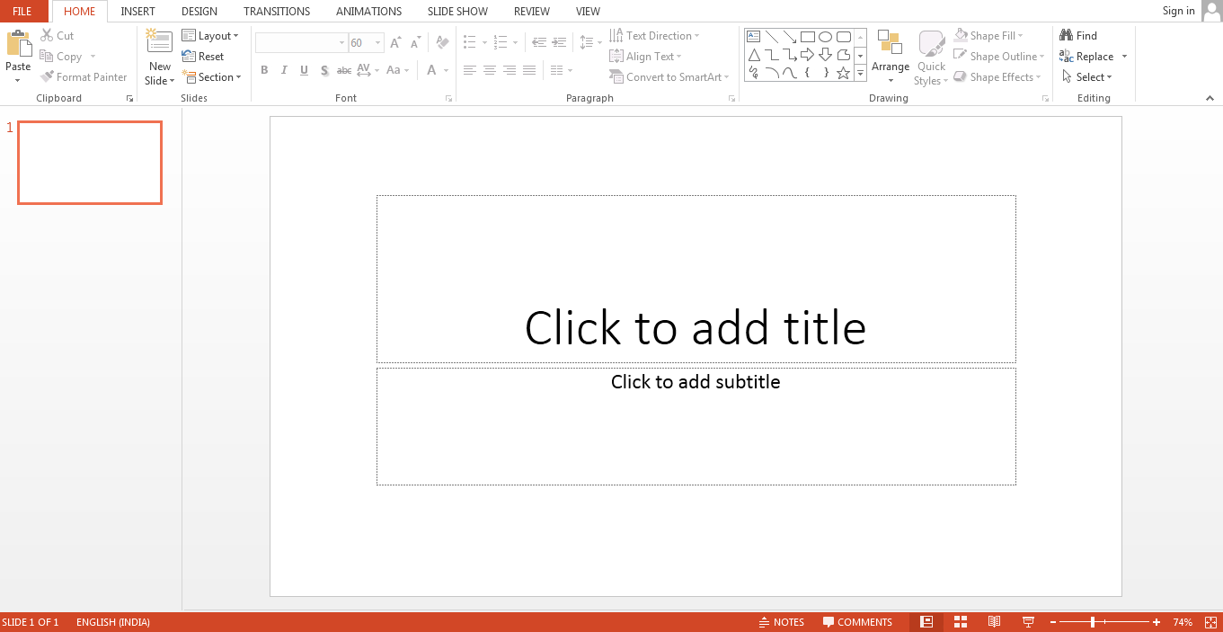
MS PowerPoint
Uses of ms powerpoint:
Create presentations from scratch or a template.
Add text, images, art, and videos.
Select a professional design with PowerPoint Designer.
Add transitions, animations, and cinematic motion.
Save to OneDrive, to get to your presentations from your computer, tablet, or phone.
Share your work and work with others, wherever they are.
PowerPoint (PPT) is a powerful, easy-to-use presentation graphics software program that allows you to create professional-looking electronic slide shows.
The image given below shows the main page of MS PowerPoint, where a person lands when the program is opened on a computer system:

Slide 14
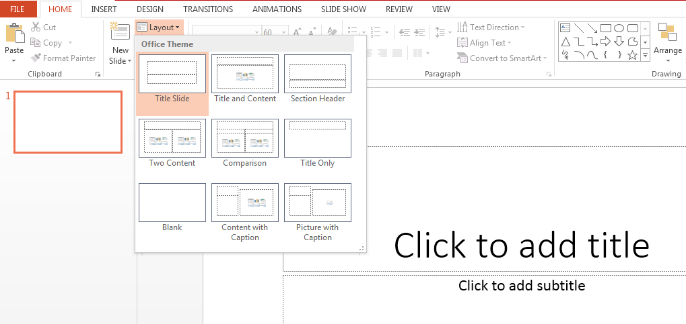
Features of MS PowerPoint:
There are multiple features that are available in MS PowerPoint which can customise and optimise a presentation. The same have been discussed below.
Slide Layout
The image below shows the different slide layout options which are available for use:

Slide 15
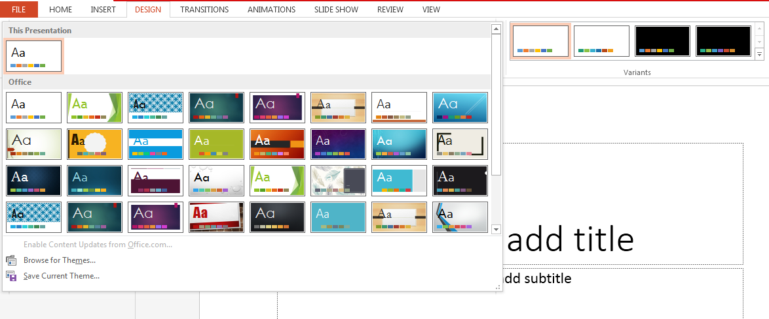
Insert – Clipart, Video, Audio, etc.
Under the “Insert” category, multiple options are available where one can choose what feature they want to insert in their presentation. This may include images, audio, video, header, footer, symbols, shapes, etc.
The image below shows the features which can be inserted:
Slide Design
MS PowerPoint has various themes using which background colour and designs or textures can be added to a slide. This makes the presentation more colourful and attracts the attention of the people looking at it.
Refer to the below for slide design:

Slide 16
Animations:
The different animation styles available on PowerPoint are:

Slide 17

Thank You

